Slide 1

SENTIMENT ANALYSIS OF FOOTBALL MATCH TWEETS
MUNEEB CHOUDHRY
ISHAAN AKBAR
AMAN AMAN

Slide 2
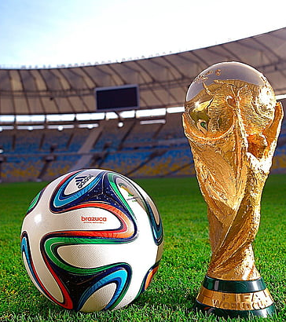
Introduction
We analyzes Twitter sentiment during sports matches using machine learning. We aim to determine how tweets react to key events like goals, fouls, and penalties. By classifying tweets as positive, negative, or neutral, we can uncover trends in fan sentiment.

Slide 3

Chosen Topic
We selected sentiment analysis in sports because social media reactions provide valuable insights into fan engagement. Twitter data helps us track emotional responses in real time, allowing teams and analysts to understand audience sentiment better.

Slide 4

Goals & Objectives
Classify
Accurately classify tweets into positive, negative, or neutral sentiment.
Identify
Identify sentiment trends during match events (goals, fouls, penalties).
Compare
Compare different models and analyze their strengths/weaknesses.

Slide 5

Scrum & Sprint
We followed an agile approach with sprints for different project phases:
Data collection and cleaning
Model selection and training
Evaluation and visualization
Refinements and documentation

Slide 6
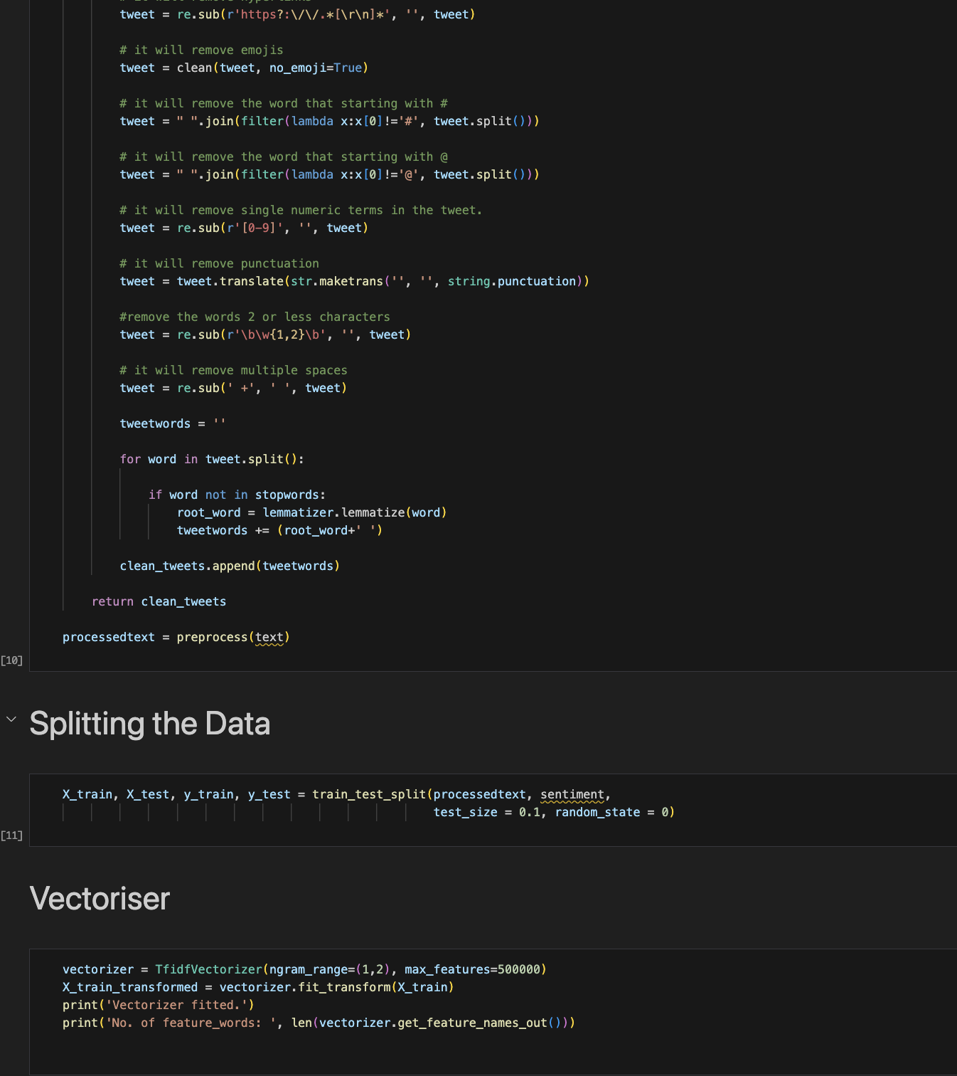
Group Roles
Member 1 (Data Handling & Preprocessing)
Collected Sentiment140 dataset.
Cleaned text (removed stopwords, tokenization, lemmatization).
Converted text to numerical format using TF-IDF & CountVectorizer.

Slide 7
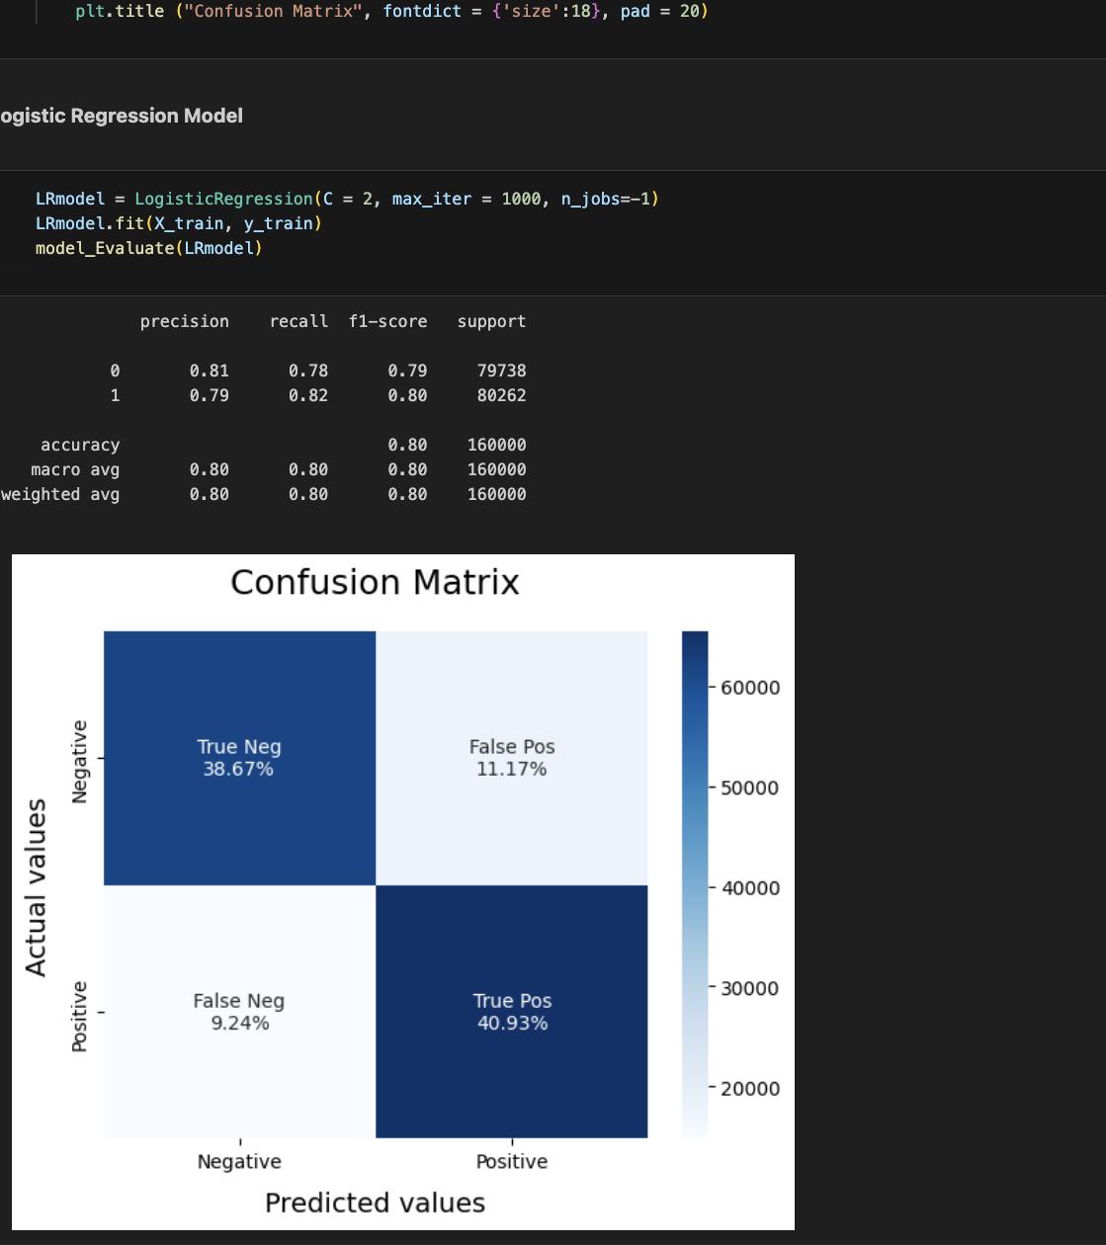
Group Roles
Member 2 (Model Development & Implementation)
Built Naive Bayes for quick classification but struggled with sarcasm.
Trained Logistic Regression, improving accuracy for complex sentiment.

Slide 8
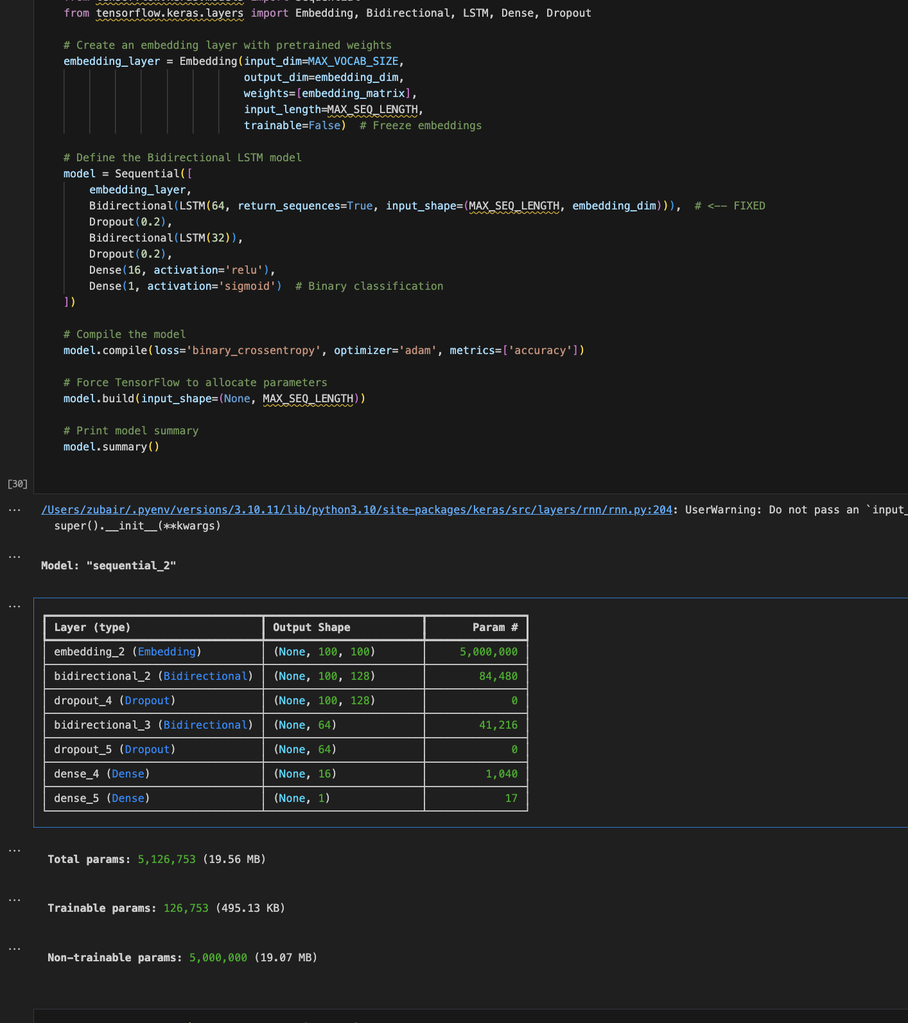
Group Roles
Member 3 (Evaluation & Visualization)
Tokenized tweets using Keras and padded sequences to a fixed length for LSTM input.
Built an LSTM model using Keras Sequential API with an Embedding layer and LSTM units.

Slide 9
CRISP Model
We followed the CRISP-DM methodology:
Business Understanding – Understanding how sentiment changes during matches.
Data Understanding – Exploring the Sentiment140 dataset from Kaggle.
Data Preparation – Cleaning, tokenization, stopword removal, lemmatization.
Modeling – Implementing Naïve Bayes, Logistic Regression, and Deep Learning.
Evaluation – Comparing accuracy and handling sarcasm/short text issues.
Deployment – Generating sentiment insights using graphs.

Slide 10

AI Development Lifecycle
Data Collection: Kaggle Sentiment140 dataset with 1.6M labeled tweets.
Preprocessing: Cleaning text, removing special characters, stopwords, and tokenizing.
Model Training: Implemented multiple classifiers and compared performance.
Evaluation: Analyzed accuracy, precision, recall, and F1-score.
Visualization: Displayed sentiment trends throughout the match.

Slide 11
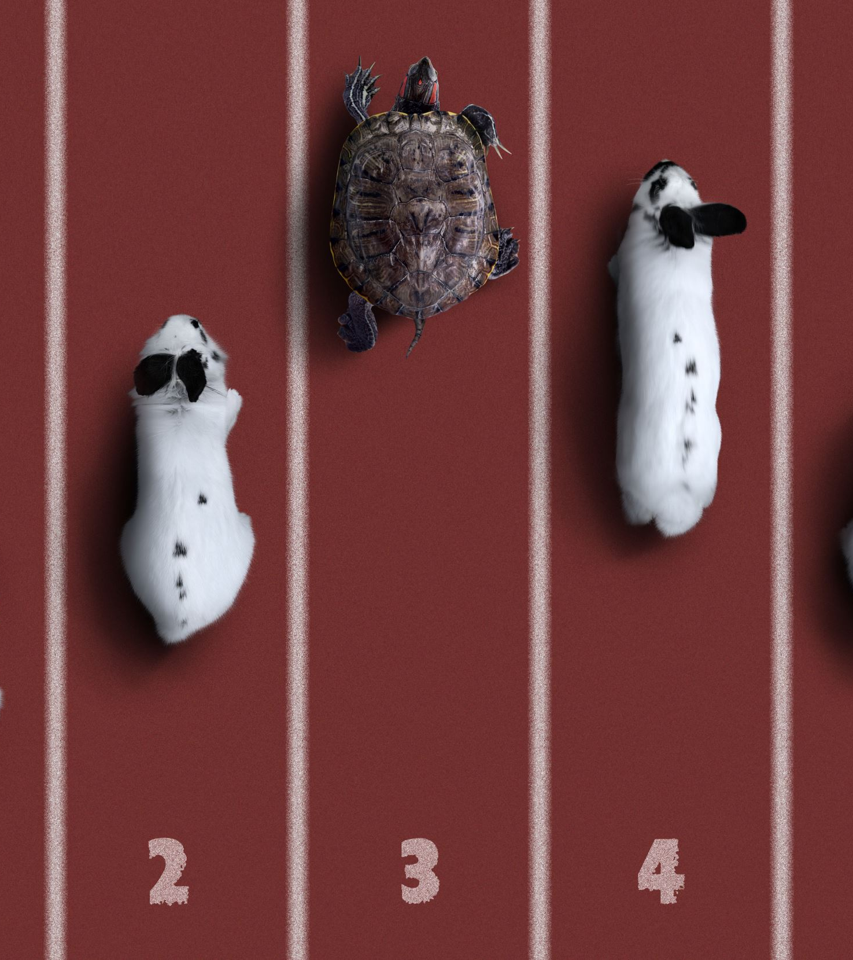
Implementation
We used Python and key libraries such as Pandas, NLTK, Scikit-learn, and Matplotlib. Models were trained using TF-IDF vectorization to transform text into numerical data for machine learning.

Slide 12
Challenges
Handling sarcasm – Traditional models struggled to detect sarcastic tweets.
Short text ambiguity – Tweets with minimal context made classification harder.
Computational complexity – Deep learning required more time and data.

Slide 13
Technical Details
Naive Bayes – Fast and efficient but weak against sarcasm.
Logistic Regression – More accurate in handling sentiment patterns.
Deep Learning (LSTM/CNN) – Best accuracy but required extensive training.
Vectorization – TF-IDF used for converting text to numerical format.

Slide 14

Testing
Models were tested using accuracy, precision, recall, and F1-score. A confusion matrix was used to analyze misclassifications.

Slide 15
Demonstration
We trained and evaluated three models (Naive Bayes, Logistic Regression, and LSTM/CNN) on the Sentiment140 dataset. Model performance was compared using accuracy, precision, recall, and F1-score.
Visualizations showed sentiment trends during match events, highlighting spikes for goals and fouls. Challenges like sarcasm and short-text ambiguity were identified for future improvements

Slide 16

Project Development
Week 1-2: Data collection and preprocessing.
Week 3-4: Model implementation and testing.
Week 5: Visualization and sentiment trend analysis.
Week 6: Report writing and presentation preparation.

Slide 17

Project Management
Microsoft Teams was used for communication, task tracking, and team collaboration. Regular meetings and discussions ensured smooth coordination and timely progress.

Slide 18
Project Review
Successes: The models accurately classified tweets, and sentiment trends matched key match events.
Improvements: Deep learning models could achieve better accuracy with more data and fine-tuning.

Slide 19

Conclusion
This project demonstrated how sentiment analysis can track real-time audience reactions. While traditional models worked well, deep learning improved accuracy but required more resources. Future enhancements could include multimodal analysis (text + images).

Slide 20

References
Kaggle Sentiment140 Dataset
Scikit-learn Documentation
Pang, B., & Lee, L. (2008). Opinion mining and sentiment analysis. Foundations and Trends in Information Retrieval, 2(1-2), 1-135.
Go, A., Bhayani, R., & Huang, L. (2009). Twitter sentiment classification using distant supervision. Stanford University Technical Paper.

Slide 21

QUESTIONS ?

